Slide 1
Introduction to college Planning
Student services
For 10th & 11th Grades

Slide 2
10th grade GOALS
FOCUS ON
ACADEMIC SUCCESS
CAREER EXPLORATION
GET INVOLVED
Many colleges want to know how you spend your free time.
Adjusting from Middle School to High School will take effort.
Access teachers during L&L, and follow up if you miss class.
Learn how to study effectively and manage your time well.
The Occupational Outlook Handbook will help you plan.
Salaries are impacted by college major more than the school you attend.
See what careers interest you, and take related courses.
Join school clubs, volunteer, continue with a sport/activity.
Working part-time demonstrates responsibility and time management.

Slide 3
10th grade TIMELINE
FIRST SEMESTER
SECOND SEMESTER
END OF YEAR / SUMMER
EXPLORE SUMMER OPPORTUNITIES (WORK, SUMMER CAMPS, VOLUNTEERING)
NARROW DOWN POSSIBLE CAREER OPTIONS
WORK ON IMPROVING DEFICIT SKILLS FROM THE PSAT / PreACT
DO YOUR BEST TO POST HIGH MP & FINAL GRADES
TAKE THE PSAT IN OCTOBER AS PRACTICE FOR THE SAT
WORK ON THE 10TH GRADE GOALS
PLAN COURSES FOR NEXT YEAR WITH YOUR SCHOOL COUNSELOR
TAKE THE PreACT IN MARCH AS PRACTICE FOR THE ACT
VISIT A COLLEGE CAMPUS IF YOU CAN

Slide 4
11th grade GOALS
LEARN ABOUT COLLEGES
CONSIDER MAJORS
COLLEGE ADMISSIONS
Plan & Prepare for SAT / ACT exams.
Evaluate your chances for being accepted to the schools you’re interested in.
Categorize schools based on admissions chances (Safety, Target, Reach).
Attend college rep visits to West during the 1st MP.
Tour colleges when you can.
Begin using college search tools, taking note of important factors.
Get a feel for what all colleges offer vs. what may be unique.
You can go as “undecided”, but you should at least explore options.
Changing majors can be handled different by each school.
Be realistic with areas of strength as you review majors.
Confirm courses are in line with expectations.

Slide 5
11th grade TIMELINE
FIRST SEMESTER
SECOND SEMESTER
END OF YEAR / SUMMER
CREATE COMMON APPLICATION / WORK ON COLLEGE ESSAY(S)
NARROW DOWN COLLEGE PREFERENCES / CREATE SHORT LIST
DISCUSS COLLEGE PLANS WITH PARENTS, INCLUDING FINANCES
DO YOUR BEST TO POST HIGH MP & FINAL GRADES
TAKE THE PSAT IN OCTOBER / PLAN DATE FOR OFFICIAL SAT or ACT
WORK ON THE 11TH GRADE GOALS
PLAN COURSES FOR NEXT YEAR WITH YOUR SCHOOL COUNSELOR
USE COLLEGE SEARCH TOOLS & BECOME FAMILIAR WITH COLLEGES
PLAN TO TAKE THE SAT OR ACT TWICE BEFORE SENIOR YEAR (AFTER ALG 2)

Slide 6
Career exploration

Slide 7
Career exploration
Don’t worry about “picking” a career yet.
You may feel pressure, but you have time.
Learn about different career fields.
The goal is to gain perspective.
Take note of what each field has to offer you.
Identify likes and dislikes for fields you’re considering.
Adjust as you learn more.
Plan as best as you can, but a lot can change over the next 6 years.
Lean towards your interests, but also factor in strengths and skills.
Notes:
Mike Start

Slide 8
Career exploration
Become familiar with options.
Learn about career fields, see what’s possible.
Review/reset Career Interest Profiler (Naviance).
Spend time researching (Occupational Outlook Handbook link).
Get a general feel for each career field.
Discuss careers with friends, family, teachers, and high school counselor.
How do people in different careers spend their day?
What is the best/worst part of their job?

Slide 9
Occupational outlook handbook
Published by the Dept. of Labor’s Bureau of Labor Statistics
Provides descriptions, median salaries, projected growth, and education requirements.
Explore “Occupation Groups” (link)
Learn about different career fields.
Use the “Occupation Finder” (link)
Search for careers across all groups based on factors.

Slide 10
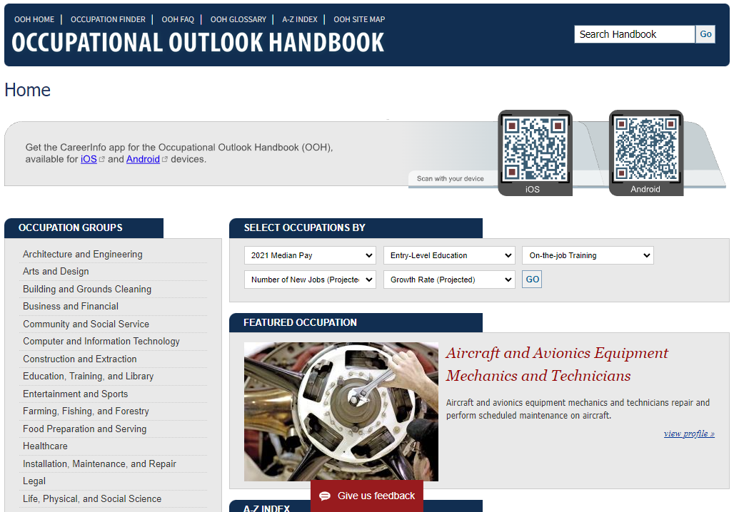
Occupation groups

Slide 11
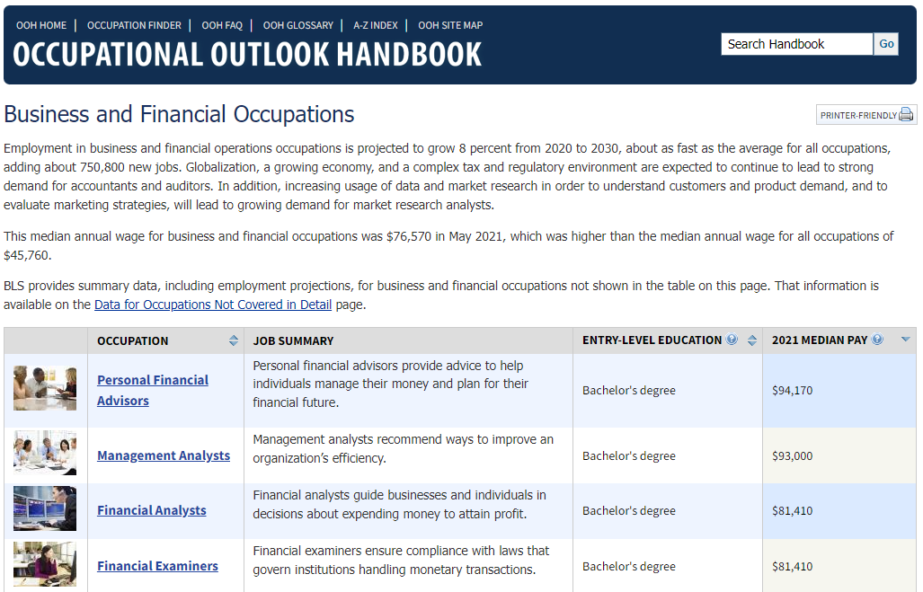
Explore careers within a field

Slide 12
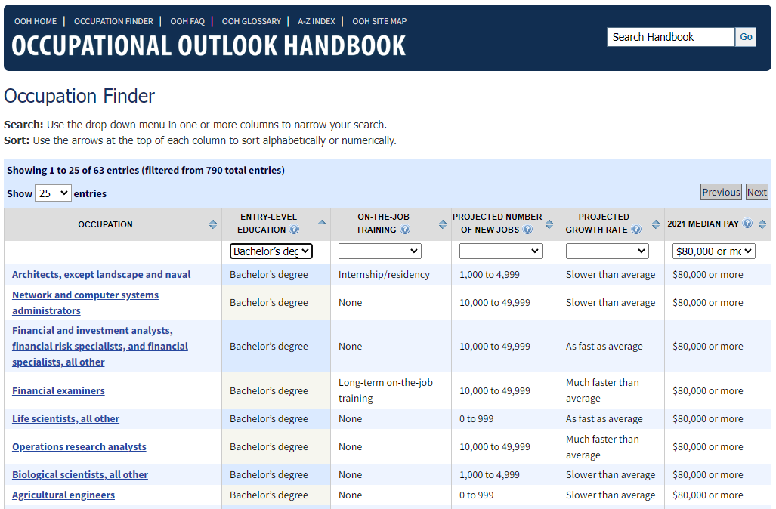
Occupation finder

Slide 13
Learn detailed info

Slide 14
Plan your path
Consider whether a college degree is beneficial.
How do career goals lineup with educational goals?
Many careers require at least a 4 yr Bachelors degree, but there are several strong options requiring a 2 yr Associates degree, or only formal training.
Consider the skilled trades if interests align.
Although you may not need a college education, schools like Penn College of Tech and Thaddeus Stevens are great “regionally accredited” options.
Notes:
Donna

Slide 15
Consider all career paths

Slide 16
Military options
Take the ASVAB (link)
ASVAB scores are required for Military enlistment.
Can be scheduled through local recruiter.
Different types of Military service (link)
For both non/college-bound students.
Naviance also has a great Military section (careers).
Reserve Officer Training Corps (ROTC)
Apply for a paid education and guaranteed post-college military career (link).

Slide 17
Military academies
Extremely competitive schools that train students to become officers in the military.
If interested, your must prepare now (link).
Uniformed Services University of the Health Sciences (USUHS)
The military also operates its own medical school.
Students pay no tuition or fees, and receive a salary and military benefits (link).

Slide 18
College planning

Slide 19
11th Grade = Very important year
Contributes to your most recent GPA when you apply.
Colleges will still see your senior year schedule
Strong year can help offset low cumulative GPA.
You can’t change low grades from the past, but can start a new “trend” of improvement
Still time to get involved!
Clubs/sports/activities/volunteering/jobs

Slide 20
College planning
Focus on “fit.”
Search for what matches your own interests.
You can’t change the past!
Even if your GPA isn’t ideal, focus on showing colleges what you are capable of this year moving forward.
Common College Destinations (about 50% of Seniors)
15% Pennsylvania State University
15% PA State School (West Chester, Bloomsburg, Kutztown, etc)
10 to 15% Bucks County Community College
7% University of Pittsburgh
4% Temple University

Slide 21
College planning
Take Ownership
STUDENTS should take the lead
Focus on YOUR interests!
Prioritize certain factors (size, location, programs).
Work Together as a Family
Discuss what’s important to your parents so you are aware of expectations.
How much will they be able to help financially?

Slide 22
College planning
College Rep. visits to CB West
Admissions Officers present to students during 1st marking period.
Great opportunity for students to learn about a college AND meet the person who will likely read your application.
Some reps will waive app fees for those who attend/or visit campus.
Sign up in Naviance, under the college tab.
What to ask the rep?
Specific programs, how easy can you change majors/undecided, campus life and nearby attractions, admissions questions… anything!
Notes:
Donna Start

Slide 23
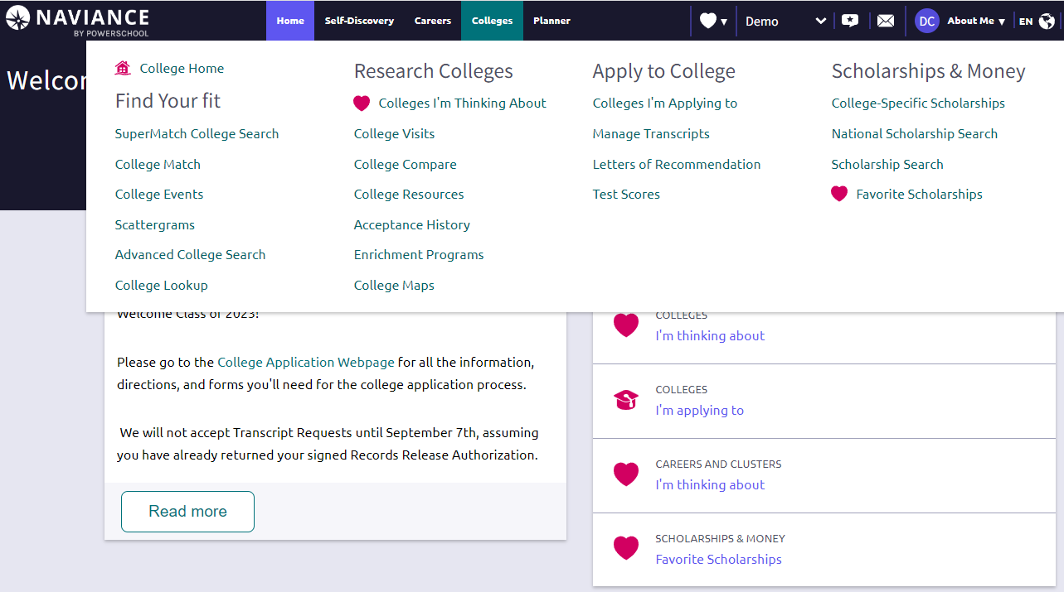
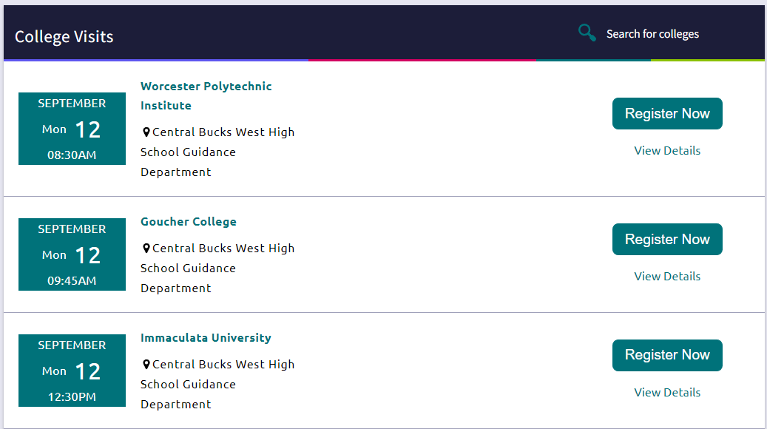

Slide 24
What to search for
Campus “feel” during visit.
Individual program design
Look at a school’s website for courses/credits that makeup the degree.
Clubs and activities
Large football school, focus on clubs, political activism, social gatherings, etc.
Internship opportunities and surrounding area.
Location, weather, and general experience.

Slide 25
Amenities
Dorm life (bathrooms, A/C, roommate options)
Gyms/pools/green spaces/other facilities
Food (on campus only vs surrounding town, meal plans)
Access to facilities based on major (labs, workshops, local businesses)

Slide 26
Naviance search tools
Login to Student Account
Naviance link on cbsd.org site, under students.
SuperMatch
Narrow colleges based on specific factors.
Identify schools matching student data (GPA,SAT/ACT Scores)
Save results to review later.
Notes:
Mike Start

Slide 27
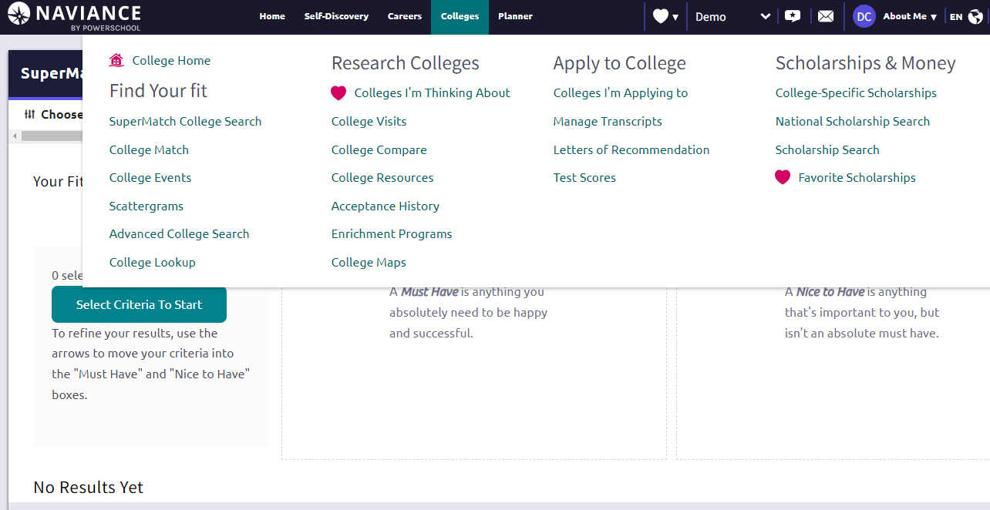
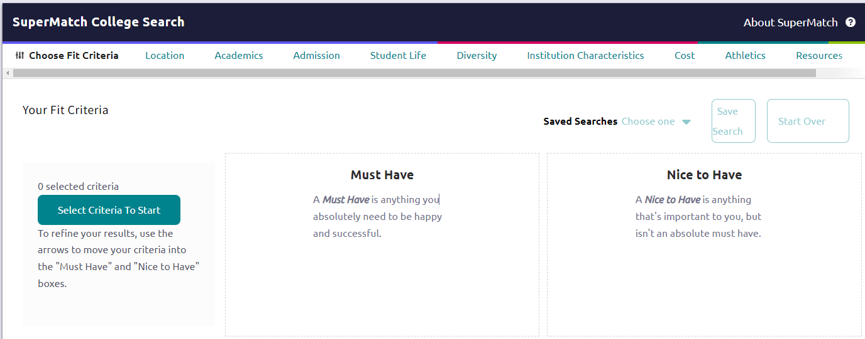
Naviance SuperMatch

Slide 28
Search factors
Use a few main factors to sort
Adding too many won’t be helpful!
Size
Small (Under 5,000)
Medium (5,000 to 15,000)
Large (15,000 + )
Location
Close to home or far away
In state vs. out of state (financial considerations)
A campus close to career opportunities
Activities on or off campus, surrounding area

Slide 29
Search factors
Majors
Run a search with one possible major.
Repeat search using a different major.
Start a list of schools that overlap.
Consider job prospects/salary of different majors.
Admissions
Try not to focus too much on admissions yet
Eventually, this will be a way to narrow your list.
Percent accepted = “selectivity”

Slide 30
Search factors
Costs
Should be part of the consideration.
Actual costs paid/loaned will often be less than the price you see on your screen.
Merit scholarships are available to students at the top end of admissions requirements for that school.
Unique Programs/Qualities
What makes the school stand out?
Something special that matches your goals.
Why is this school the right one for you?

Slide 31
College admissions
the final search factor

Slide 32
What is considered
Colleges will primarily focus on GPA and rigor (Honors & AP levels).
Recent grades CAN help counterbalance a low GPA!
Did you know that a “B-” converts to a 2.6 GPA?
SAT / ACT scores
Part of admissions decisions
Also important for Merit Aid
Personal Statement/Essay
Opportunity to speak to admissions in your own voice
Ask yourself, “What do I want them to know about me when they read this?”
Extracurricular activities, athletic involvement, and recommendations round out the process.
Notes:
Donna Start

Slide 33
What are the SAT / ACT?
The SAT and ACT are standardized exams used as part of college admissions & merit scholarships for many schools.
These exams are designed to take a snapshot of where students stand in terms of college readiness.
Colleges will accept scores for either exam.
Choose the exam format you score higher on, or like better.
There are score conversion charts that let you compare scores.

Slide 34
key points during 11th
Fall:
Career exploration and preparing for the college entrance exams (SAT / ACT).
College Rep Visits at West.
Do as well as possible in classes.
Winter/Spring:
Narrow potential colleges by desired factors.
Begin to compare admission requirements with your exam scores and GPA.
Plan for any required classes during Sr year.

Slide 35
Summer goals
Update your Resume
Useful when completing applications.
Don’t list everything, focus on most meaningful to you.
Should fit on one page until later in your career.
Start your College Apps
Finalize your list.
Create accounts (Common App, College Websites, etc)
Enter in as much info as you can.
Write your Essays.
Visit Colleges
You can wait until Senior year to visit schools you are accepted to.

